Slide 1


Next page
Module ①
From CSR to ESG
A journey to achieve sustainability

Slide 2
Next page
Module
①
Special Features
01
Linkage of CSR & ESG
(Est. time: 6 mins)
Build sustainability into your
business strategy
02
Embody managerial traits in pursuing
ESG practices
03
ESG integration from Asian perspective
Please refer to Section 1 of the word document for more readings related to Learning Objective 01.

Slide 3


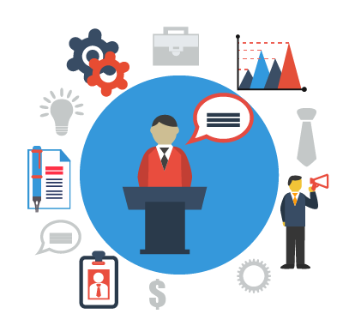


1. Linkage of CSR & ESG
Next page
1.1 CSR Definition
Corporate Social
Responsibility
Social
Justice
Economic
Progress
Environmental
Preservation
Corporate Social Responsibility (CSR) is a general framework to promote sustainability in everyday activities by businesses. The overall goal is to combine economic progress, social justice, and environmental preservation. The concept has been given rise about integrating social, environmental and ethical concerns into the business process. It is strategic in nature, driven by competitiveness, and integrated in business processes in the current times.

Slide 4
Module
①
This is the end of sample presentation.
For the full version, please contact us to
subscribe our ESGi service.

Slide 5
Appendix: Script P0
Welcome! This is module 1 for learning how CSR is transforming into ESG, the journey to achieve sustainability. Let’s start learning!

Slide 6
Appendix: Script P1
In this module, there are three major learning outcomes. First, we will understand the linkage between CSR and ESG. Second, we explore the managerial traits to pursue ESG practices in firms. Finally, we talk about how ESG is integrated in investment portfolio from an Asian perspective. Let’s begin our first section, we will look at how the CSR strategies are connected with ESG initiatives in building sustainable business.

Slide 7
Appendix: Script P2
CSR, Corporate Social Responsibility is a general framework to promote sustainability in everyday activities by businesses. The overall goal is to combine economic progress, social justice, and environmental preservation. The concept has been given rise about integrating social, environmental and ethical concerns into the business process. It is strategic in nature, driven by competitiveness, and integrated in business processes in the current times.

